Slide 1
Group Seven US Obesity Analysis
Chris, Richard, Swapna

Slide 2
About the Data
6 states had an obesity prevalence of 35 percent or higher among non-Hispanic White adults.
15 states had an obesity prevalence of 35 percent or higher among Hispanic adults.
34 states and the District of Columbia had an obesity prevalence of 35 percent or higher among non-Hispanic Black adults.
By Education and Age
Obesity decreased by level of education. Adults without a high school degree or equivalent had the highest self-reported obesity (36.2%), followed by high school graduates (34.3%), adults with some college (32.8%) and college graduates (25.0%).
Young adults were half as likely to have obesity as middle-aged adults. Adults aged 18-24 years had the lowest self-reported obesity (18.9%) compared to adults aged 45-54 years who had the highest prevalence (37.6%).
Across States and Territories
All states and territories had more than 20% of adults with obesity.
20% to less than 25% of adults had obesity in 1 state (Colorado) and the District of Columbia.
25% to less than 30% of adults had obesity in 13 states.
30% to less than 35% of adults had obesity in 23 states, Guam, and Puerto Rico.
35% or more adults had obesity in 12 states (Alabama, Arkansas, Indiana, Kansas, Kentucky, Louisiana, Michigan, Mississippi, Oklahoma, South Carolina, Tennessee, and West Virginia).
The Midwest (33.9%) and South (33.3%) had the highest prevalence of obesity, followed by the Northeast (29.0%), and the West (27.4%).

Slide 3
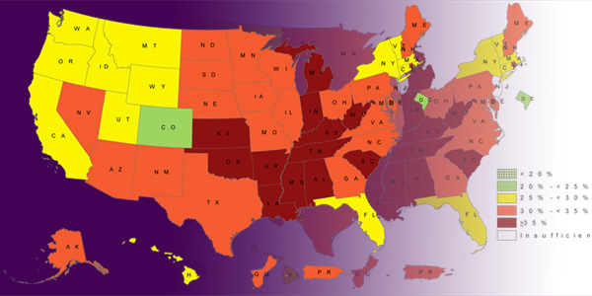
Obese and Overweight Rates By State

Slide 4
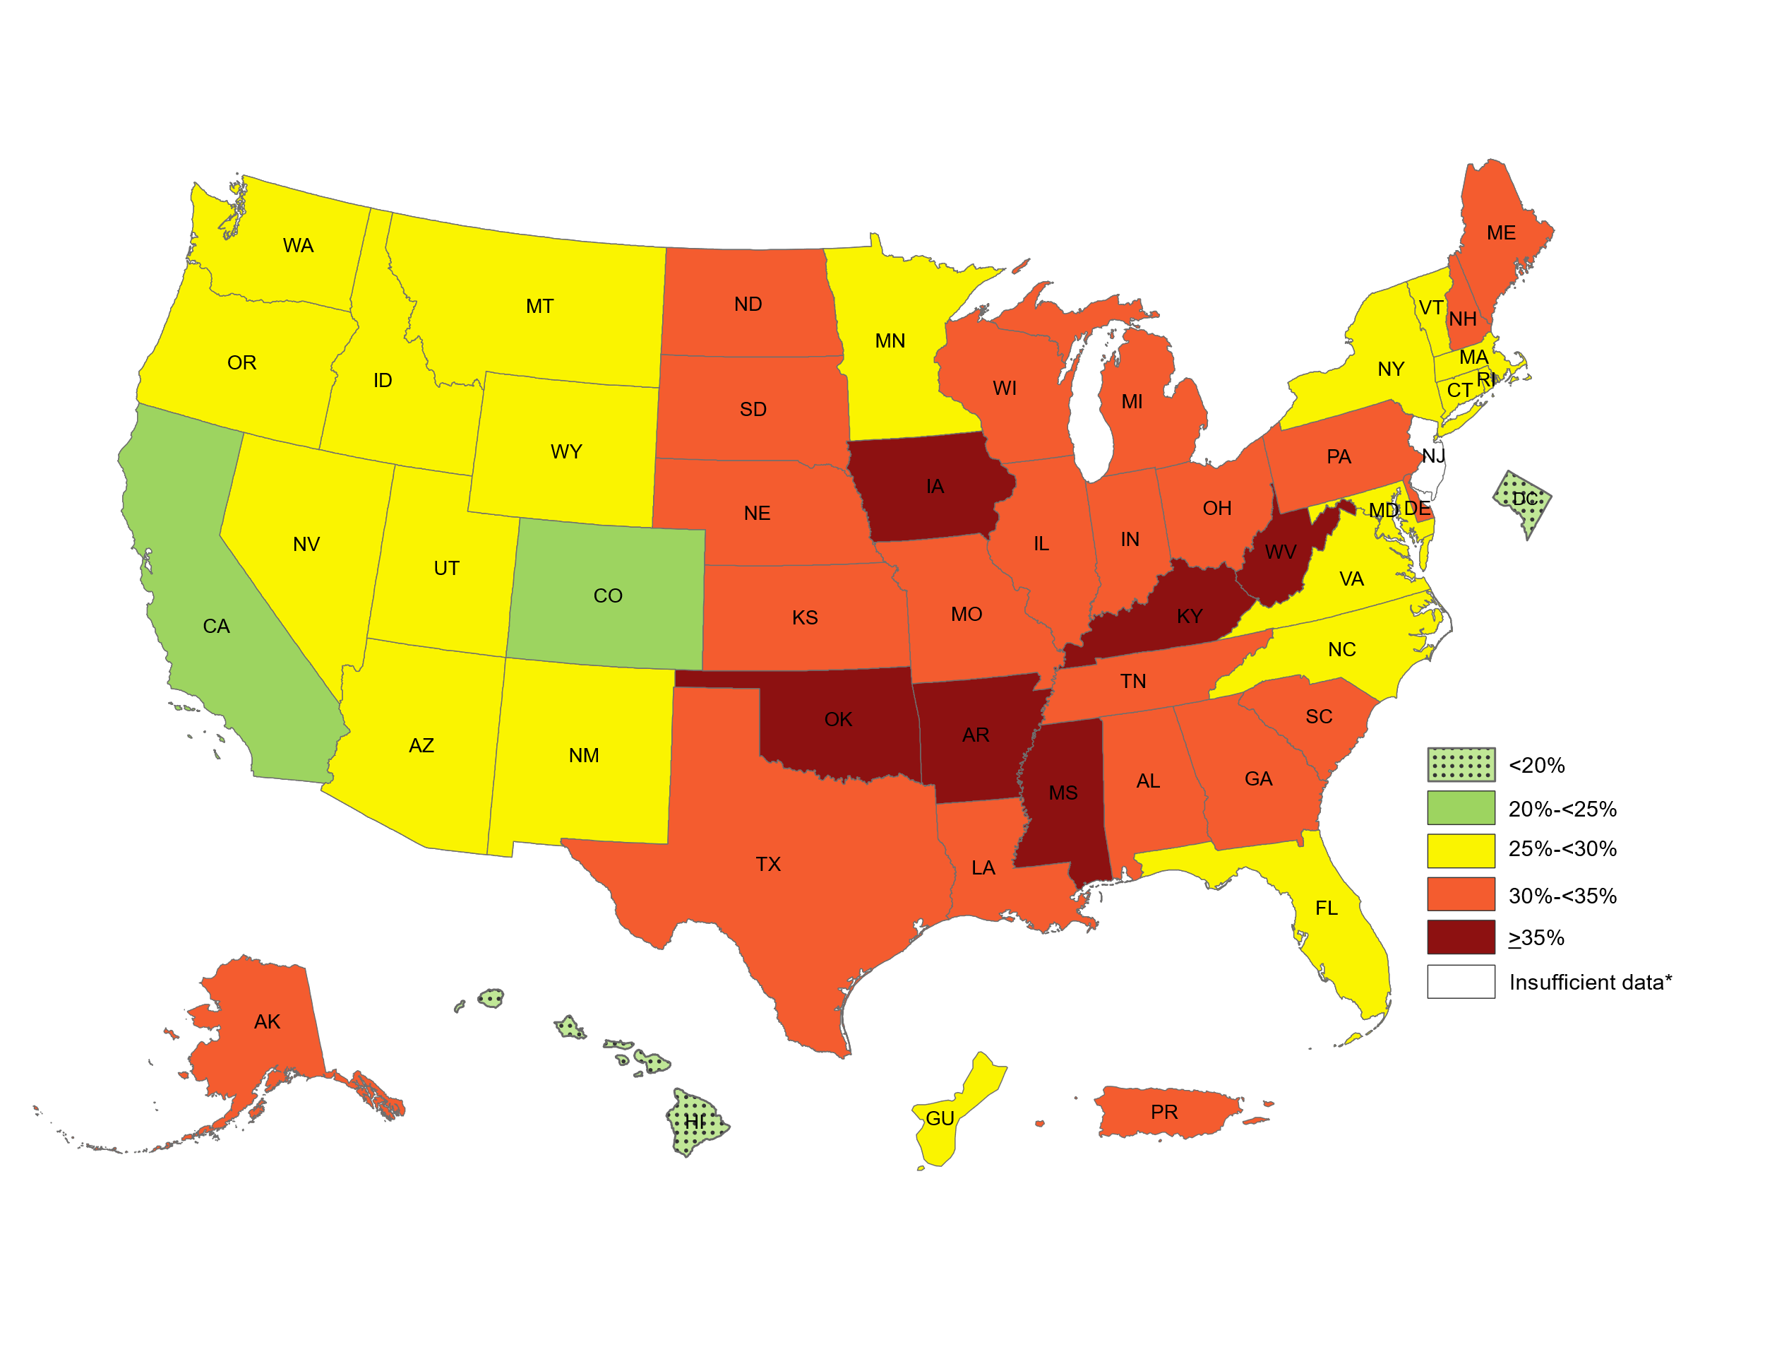
Non-Hispanic White Adults

Slide 5
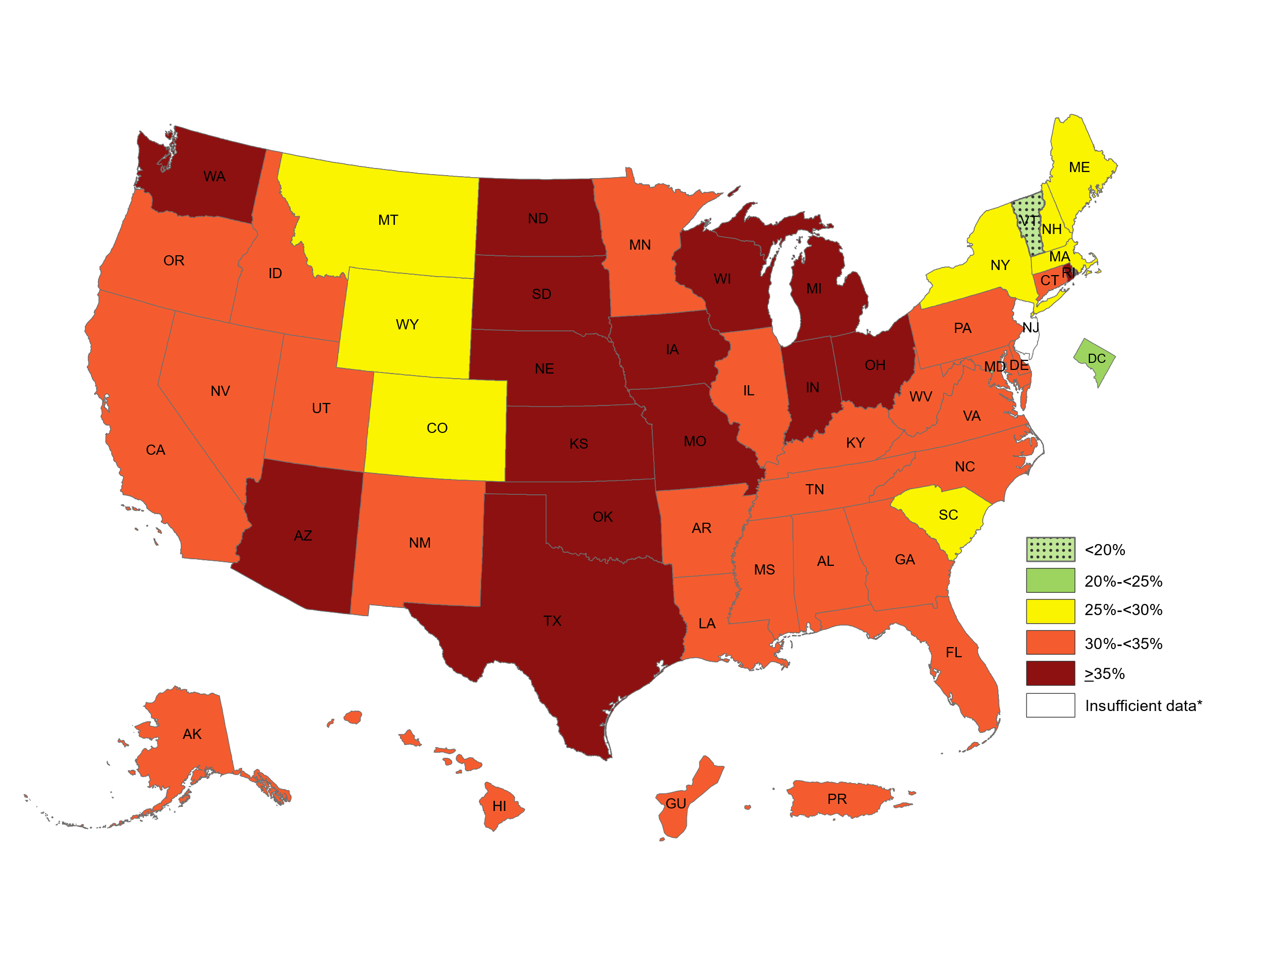
HISPANIC Adults

Slide 6
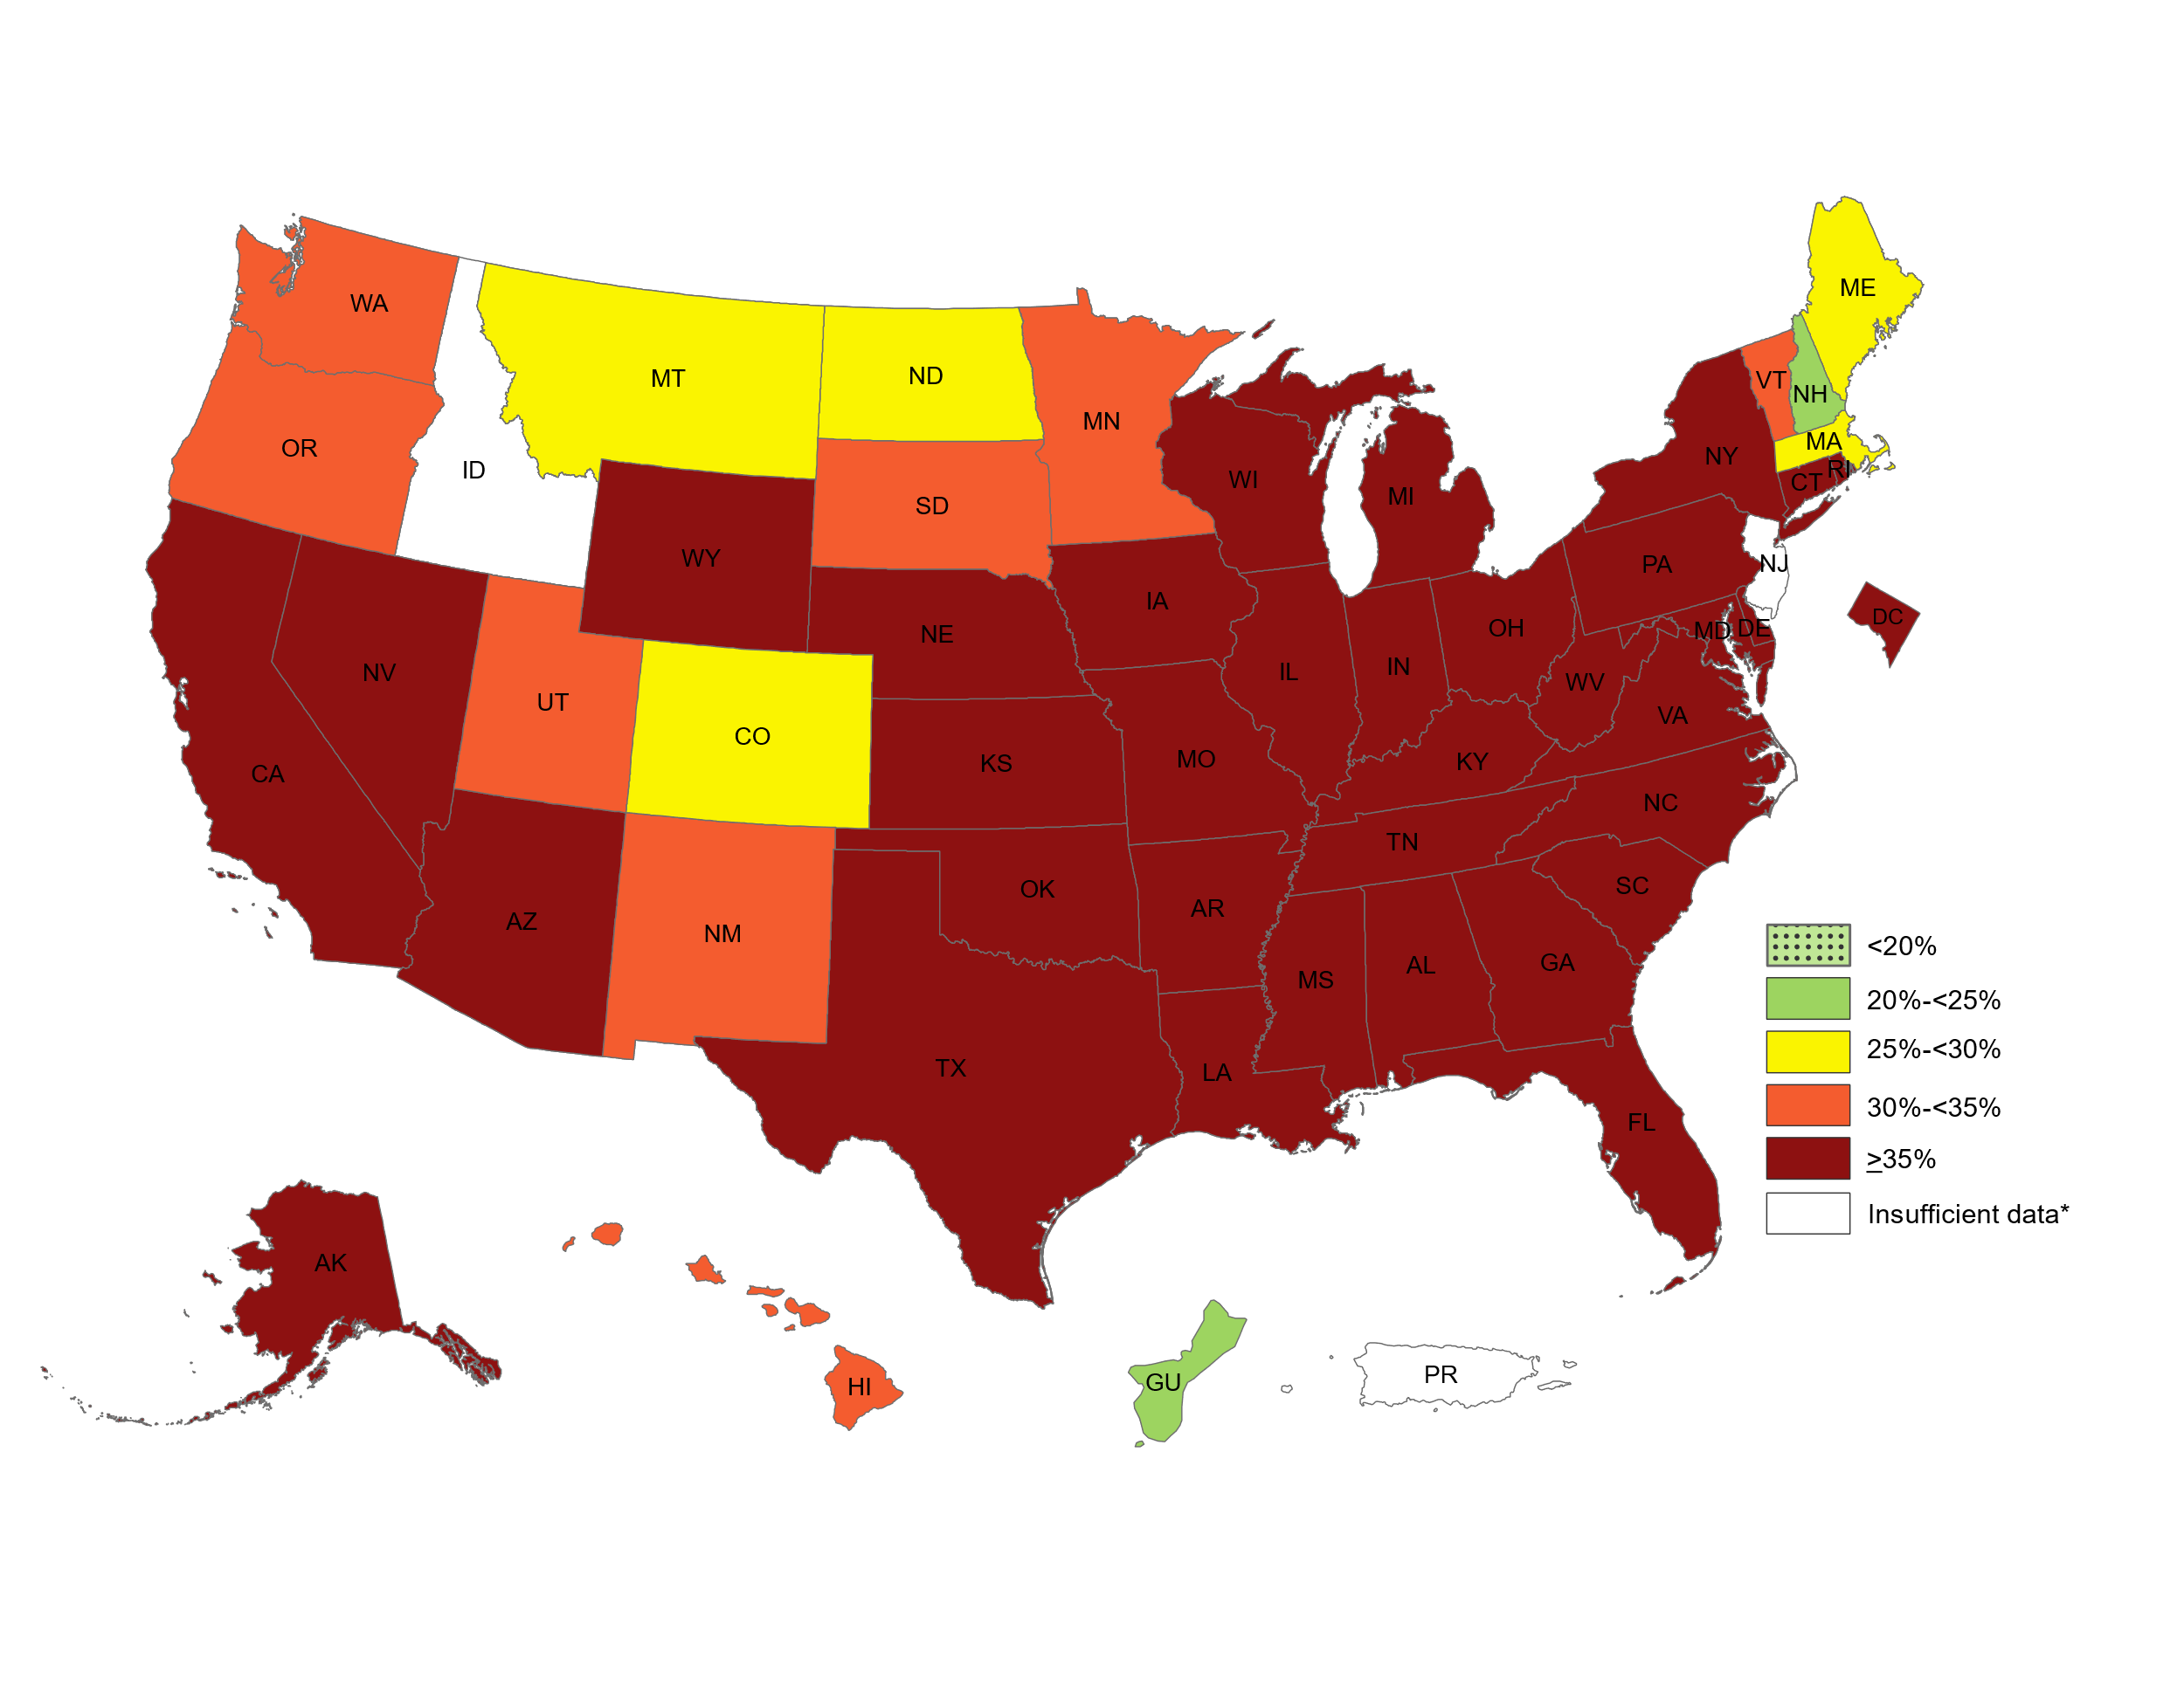
Black adults

Slide 7
WEIGHT CLASSIFICATIONS
Obese = BMI of Over 29.9
Overweight = BMI of 25.0 to 29.9
Normal Weight = BMI of 18.5 to 24.9
Underweight = BMI of 12.0 to 18.4

Slide 8
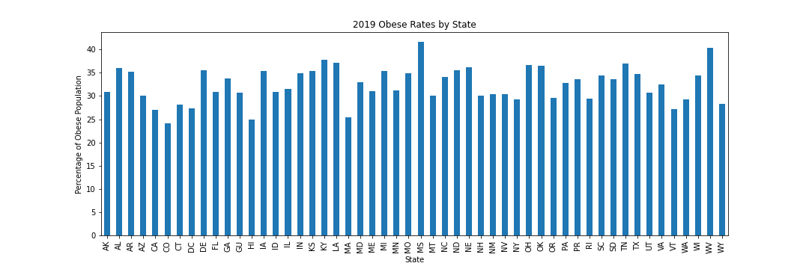
State by State Comparison

Slide 9
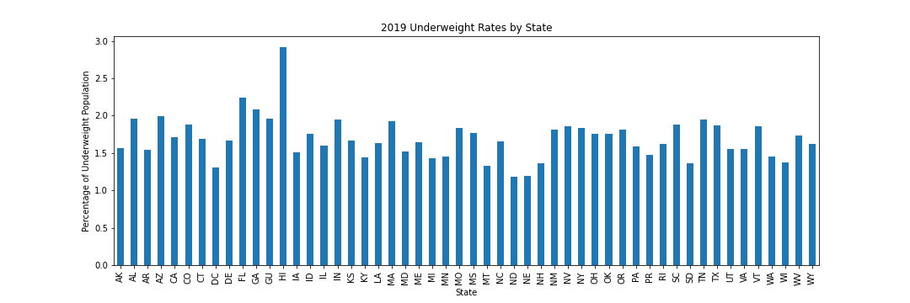
Is anyone underweight?

Slide 10
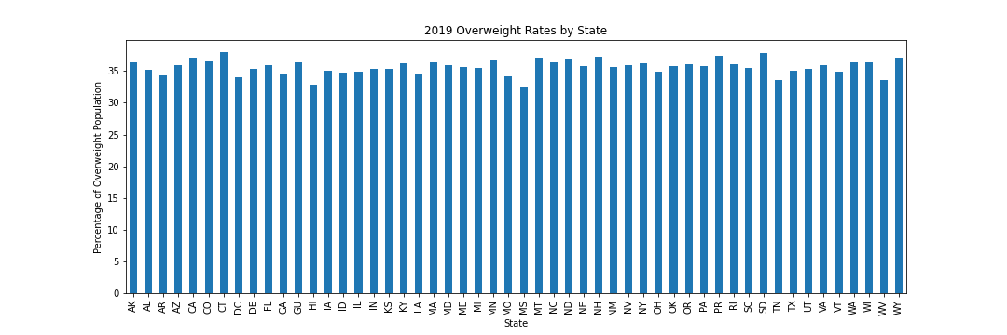
Overweight

Slide 11
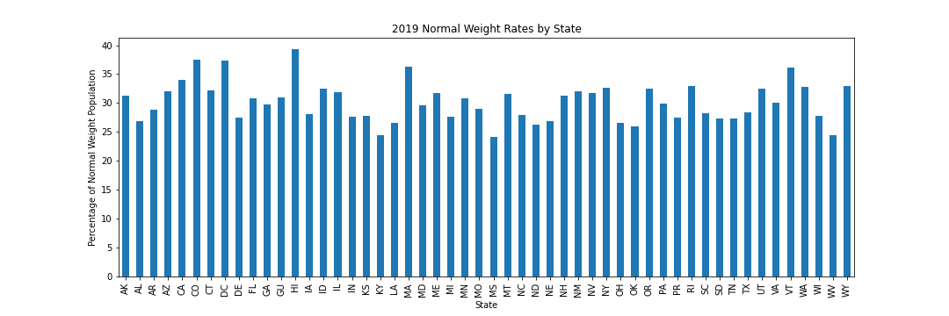
Underweight

Slide 12
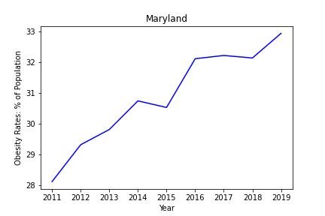
The despot's heel is on thy shore, Maryland!

Slide 13
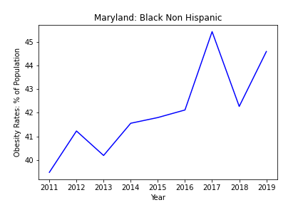
Groups: race

Slide 14
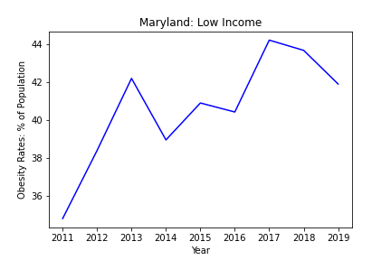
Groups: INcome

Slide 15
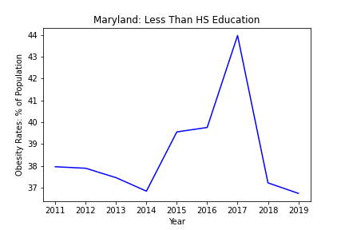
Groups: Education

Slide 16
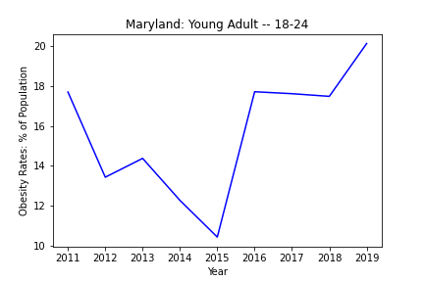
Groups: Age

Slide 17
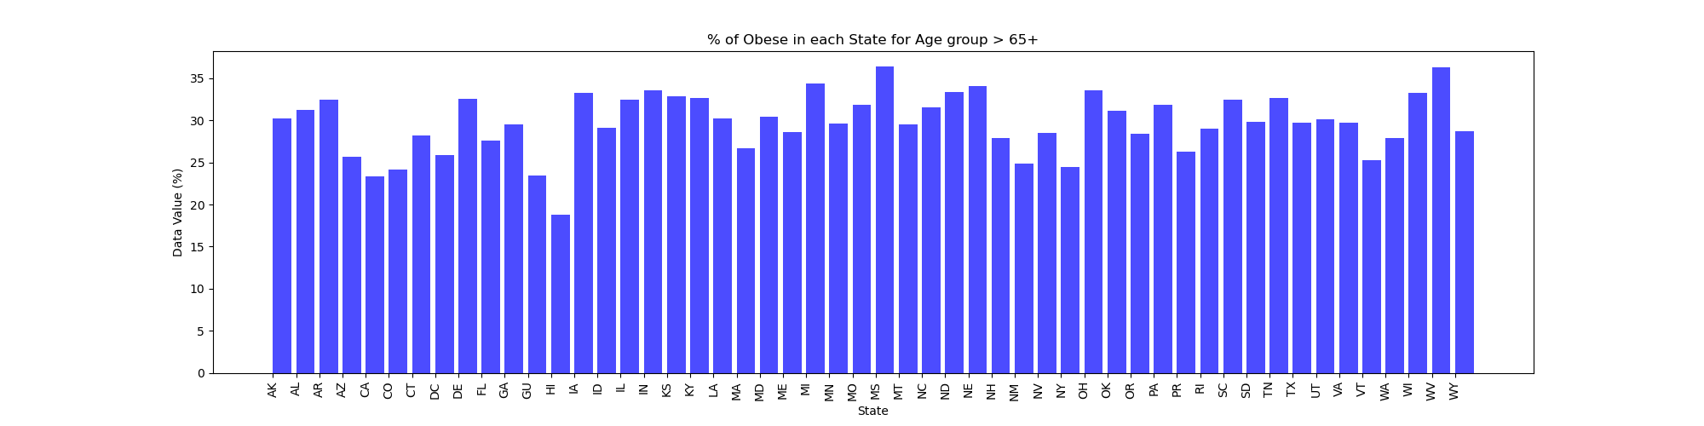
Age Groups By State: Over 65

Slide 18
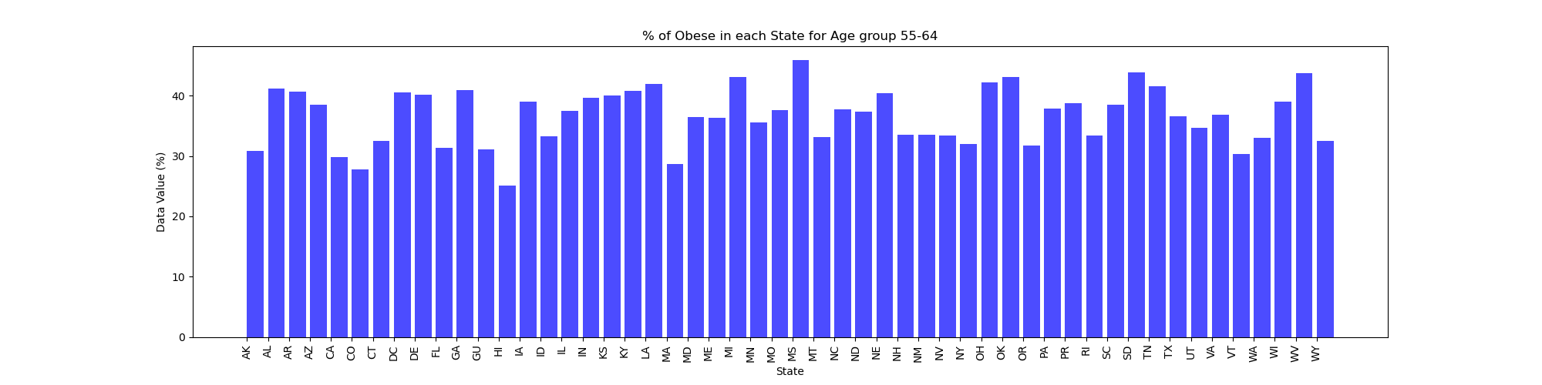
55 - 64

Slide 19
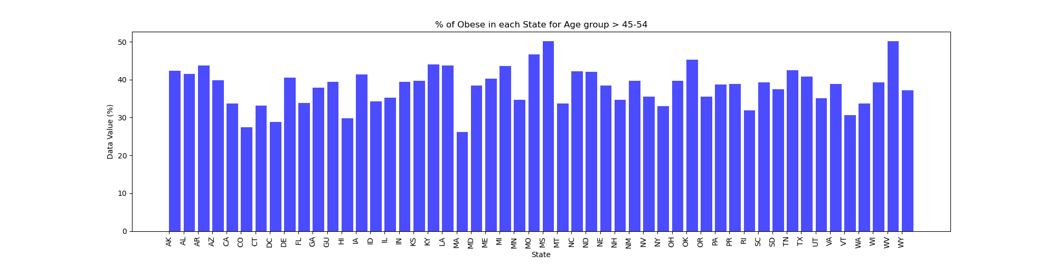
45 - 54

Slide 20
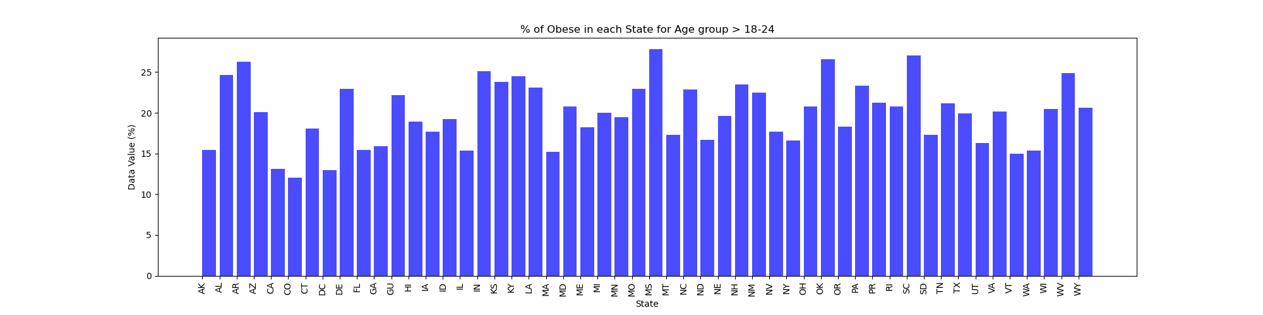
18 - 24

Slide 21
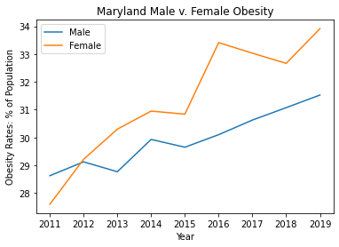
Gender

Slide 22
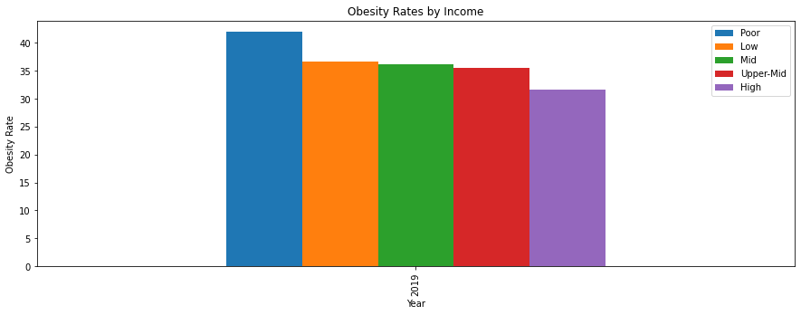
Income

Slide 23
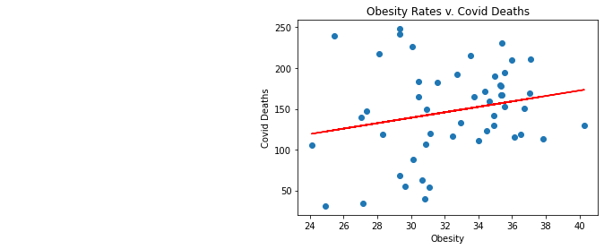
Obesity v. COVID
The correlation coefficient between 2019 obesity and covid deaths in the United States is 0.22

